Slide 1
Comparative Investigation of Factors Contributing to Suicidal Deaths in the USA and Other Nations
Team#1 Ajay Kumar, Khawar Shehzad

Slide 2
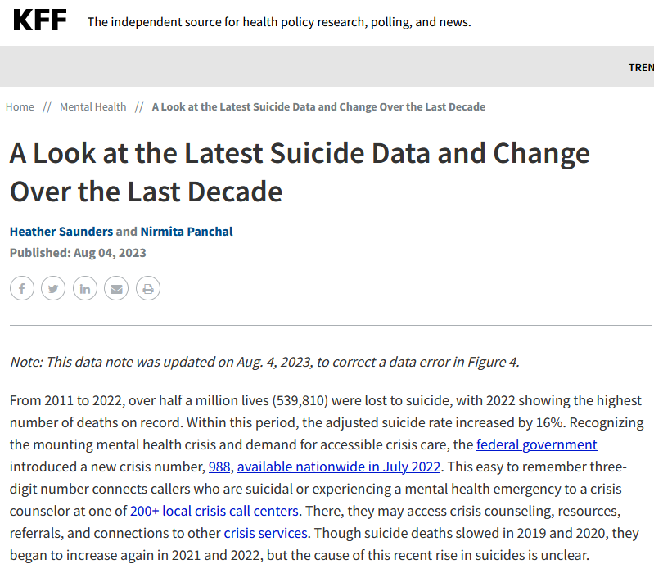
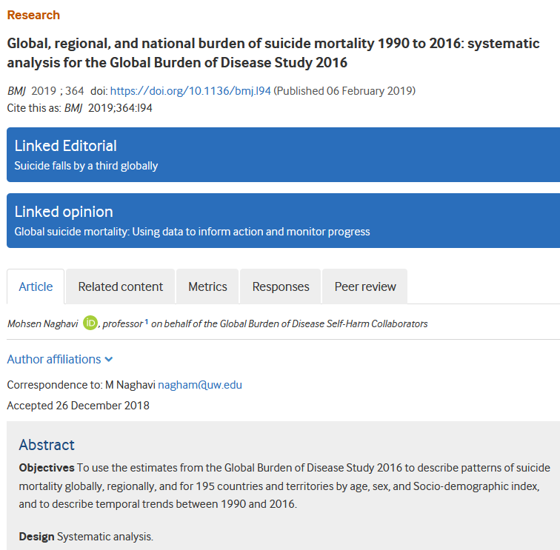
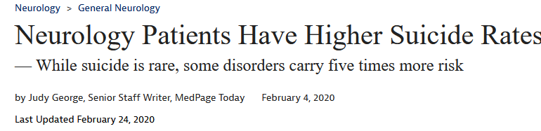
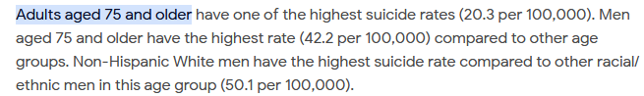
Problem Statement
Investigation to find out measures responsible for suicidal deaths in USA and comparative analysis with other countries
As per the World Health Organization (WHO) 2022 report, suicide deaths is a second major rising concern globally (800k suicides/year) that means one person every 40 seconds.
The reasons for suicide varies for every country due to economic factors, mental health challenges, cultural and media influences, access to lethal means etc.
As per the literature review from 1997 to 2017, the most common reason is legal firearms in USA.
Suicide death rates in 2021 were highest among American Indian and Alaska Native people, males, and people who live in rural areas.
*Rising deaths due to heart-attack is still a first major concern, worldwide.

Slide 3
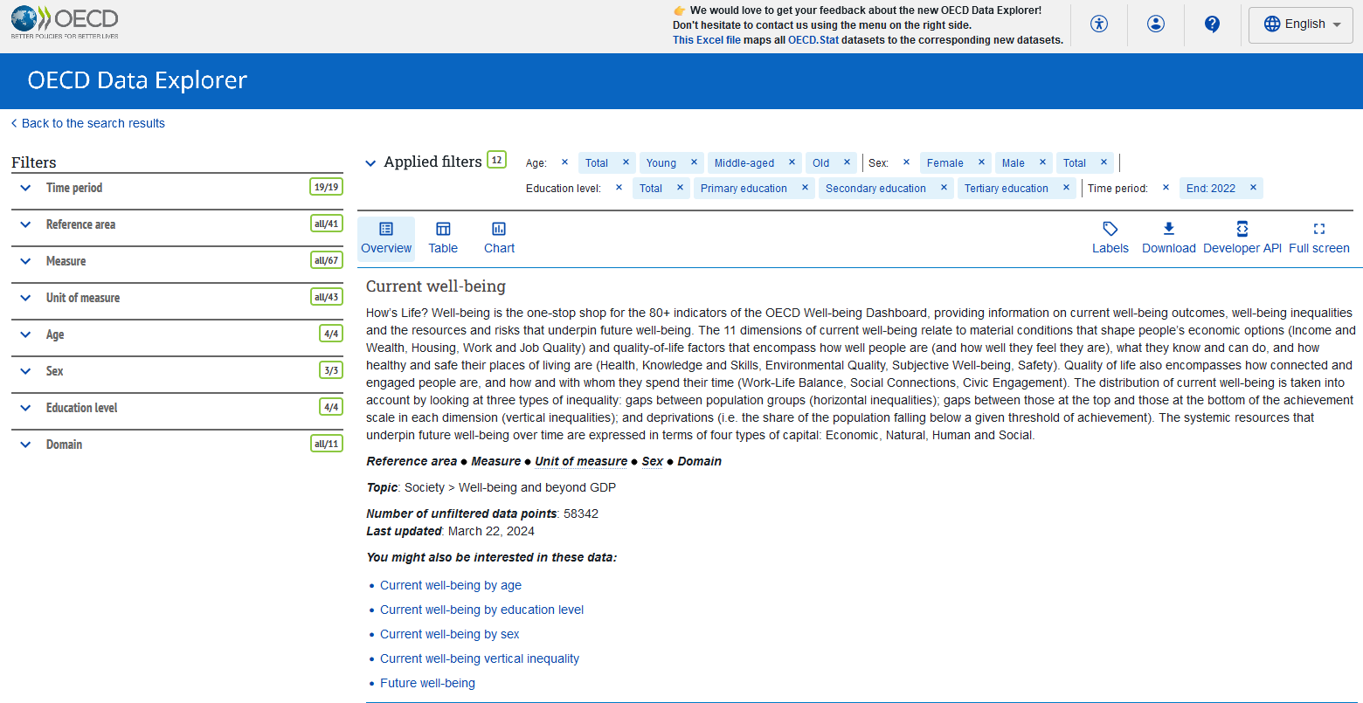
DATASET
Time-period ranged from 2004 to 2022
Education level categorized as:
Primary education, Secondary education, Tertiary education and Total
Sex has three: Male, Female and Total population observations
Reference area has 41 countries of data
Age categorized into:
Young, Middle-aged, Old and Total
Measure is considered as attributes
Downloaded whole dataset
Released data accessed from: https://data-explorer.oecd.org/vis?tm=how%27s%20life%3F%20well-being&pg=0&hc[Domain]=Subjective%20well-being&snb=11&df[ds]=dsDisseminateFinalDMZ&df[id]=DSD_HSL%40DF_HSL_CWB&df[ag]=OECD.WISE.WDP&df[vs]=1.0&pd=%2C2022&dq=...OLD%2BMID%2BYOUNG%2B_T.F%2BM%2B_T.ISCED11_5T8%2BISCED11_2_3%2BISCED11_1%2B_T.&ly[rw]=REF_AREA&ly[cl]=MEASURE%2CUNIT_MEASURE&to[TIME_PERIOD]=false&vw=ov
Chosen outcome: SAD_Deaths_Age:total_Sex_Total_Education_Total
Team#1 Ajay Kumar and Khawar Shehzad

Slide 4
DATASET
Processed data
Input variables: 187 features considered (subfactors not included here)
Output variable:
SAD_Deaths
Life satisfaction LS
Long-term unemployment rate LTUR
Voter turnout VT
Youth not in employment, education or training NEET
Perceived health as positive PH+
Employment rate ER
Long hours in paid work LHWPW
Homicides H
Life expectancy at birth LE
Average annual gross earnings AAGE
Full-time employees earning less than two-thirds of gross median earnings FTUELT
Households and NPISHs net adjusted disposable income per capita HDI
Perceived health as negative PH
Housing affordability HA
Top earnings of full-time employees decile TEFTED
Gender wage gap GWG
Road deaths RD
Job strain JS
Exposed to air pollution EAP
Feeling safe at night FSAN
Negative affect balance NAB
Social support SS
Student science skills SSS
Labour market insecurity LMIS
Households with internet access at home HIAH
Student reading skills SRS
Time off TO
Time spent in social interactions TSISI
Households living in overcrowded conditions HO
Poor households without access to basic sanitary facilities PHWABSF
Housing cost overburden HCO
Top wealthiest households decile TWHSD
Median net wealth MNW
Adult literacy skills ALS
Having a say in government HSG
Not having a say in government NHSG
Adult numeracy skills ANS
Top adult literacy scores decile TALS
Adults with low numeracy skills AWLNS
Adults with low literacy skills AWLLS
Top adult numeracy scores decile TANS
Household disposable income below the relative income poverty line HDBRIP
Students with low science skills SWLSS
Top science scores decile TSSD
Students with low reading skills SWLRS
Students with low mathematics skills SWLMS
Top reading scores decile TRSD
Gender gap in working hours GGWH
Top mathematics scores decile TMSD
Top average household disposable income quintile TAHDIQ
Equivalised liquid financial assets below three months of the annual national relative income poverty line ELFA
Long unpaid working hours LUWH
*Subfactors includes Age, Education and Sex category.
Chosen outcome: SAD_Deaths_Age:total_Sex_Total_Education_Total
Team#1 Ajay Kumar and Khawar Shehzad

Slide 5
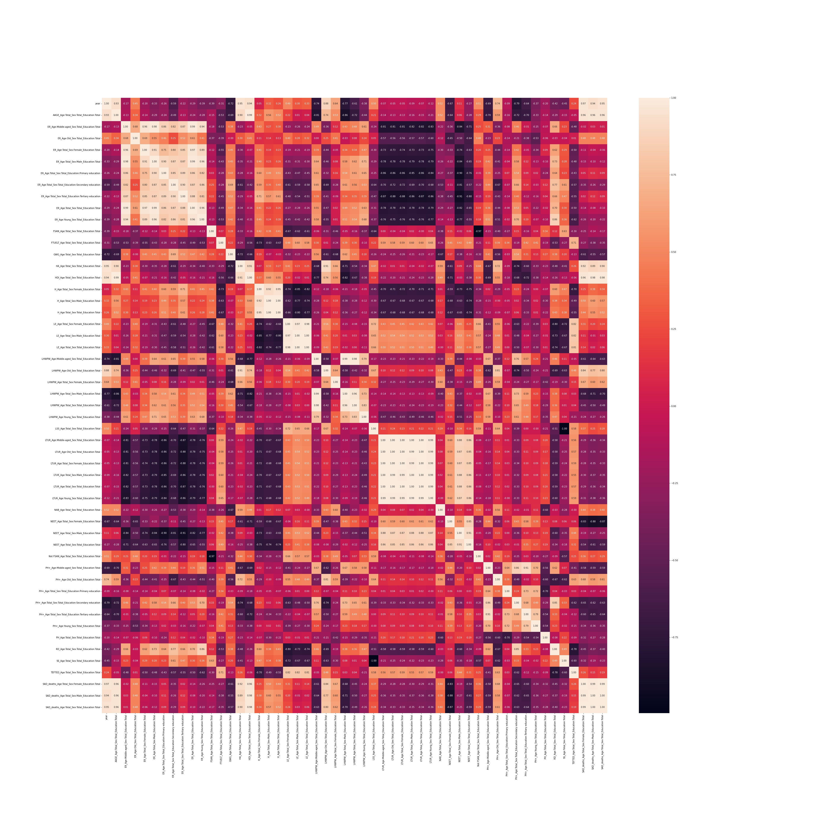
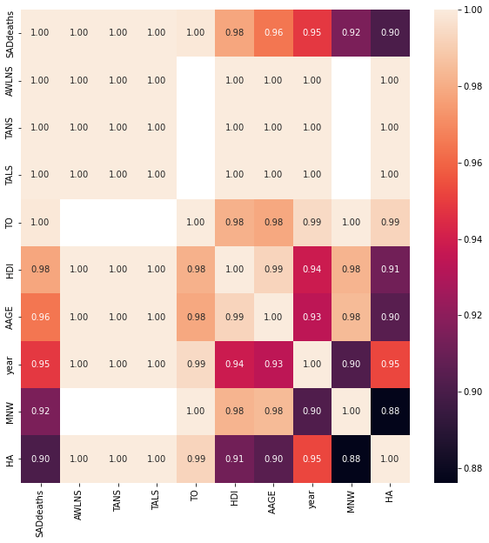
Data analysis
United States
Heatmap for trimmed features (~57 features)
Top measures might be responsible for increase suicides in USA
AWLNS – Adults with no numerical skills
HA – Housing Affordability
MNW – Median net wealth
HDI – Households and NPISHs net adjusted disposable income per capita
AAGE – Annual average gross earnings
TANS – Top adult numeracy score decile
TO – Time-off
HDI – Households and NPISHs net adjusted disposable income per capita
YEAR – Time period
Team#1 Ajay Kumar and Khawar Shehzad

Slide 6
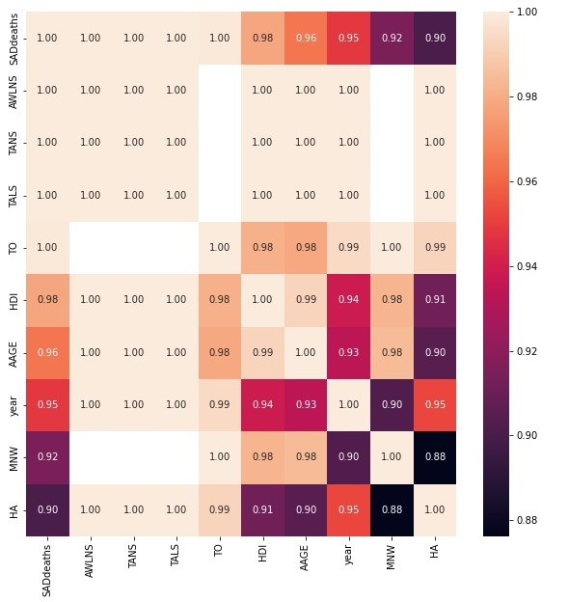
Data analysis
Globally
Top measures might be responsible for increase in suicides globally:
Heatmap for trimmed features
AWLNS – Adults with no numerical skills
TANS – Top adult numeracy score decile
TALS – Top adult literacy scores decile
AAGE – Annual average gross earnings
YEAR – Time period
HA – Housing Affordability
MNW – Median net wealth
TO – Time-off
HDI – Households and NPISHs net adjusted disposable income per capita
Team#1 Ajay Kumar and Khawar Shehzad

Slide 7
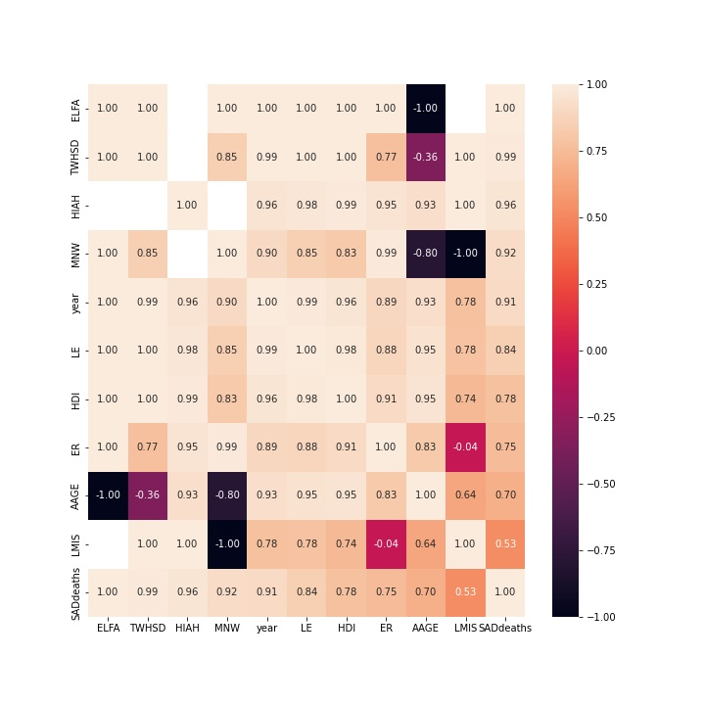
Data analysis
For other countries,
Australia
Japan
Germany
ELFA, TWHSD, HIAH, MNW, YEAR, LE, HDI, ER, AAGE
RD, H, FTUELT, NEET, GWG, VT, JS, MNW, TSISI
ER, LHWPW, VT, EAP, TEFTED
ELFA: Equivalized liquid financial assets below three months of the annual national relative income poverty line; TWHSD: Top wealthiest households' decile; HIAH: Households with internet access at home; MNW: Median net wealth; YEAR: Time-period; LE: Life expectancy at birth; HDI: Households and NPISHs net adjusted disposable income per capita; ER: Employment rate; AAGE: Average annual gross earnings.
ER: Employment rate; LHWPW: Long hours in paid work; VT: Voter turnout; EAP: Exposed to air pollution; TEFTED: Top earnings of full-time employees' decile.
RD: Road deaths; H: Homicides; FTUELT: Full-time employees earning less than two-thirds of gross median earnings; NEET: Youth not in employment, education or training; GWG: Gender wage gap;
Voter turnout; JS: Job strain; MNW: Median net wealth; TSISI: Time spent in social interactions; VT: Voter turnout.
Team#1 Ajay Kumar and Khawar Shehzad

Slide 8
Models
Compared among different models to predict SAD_death outcome from trimmed attributes
(Pearson-correlation (RMSE) )
0.84 (0.13)
Location | Linear Regression | Random Forest | Decision Tree | SVR | Gradient Boosting
United States | 0.84 (0.13) | 0.98 (0.09) | 0.94 (0.09) | 0.95 (0.20) | 0.98 (0.06)
Australia | 0.76 (0.12) | 0.59 (0.17) | 0.71 (0.30) | 0.72 (0.14) | 0.68 (0.27)
Japan | 0.93 (0.20) | 0.99 (0.19) | 0.99 (0.07) | 0.99 (0.18) | 0.98 (0.18)
Germany | 0.60 (0.39) | 0.36 (0.60) | 0.55 (0.48) | 0.69 (0.46) | 0.91 (0.47)
global | 0.79 (0.10) | 0.95 (0.05) | 0.90 (0.07) | 0.89 (0.07) | 0.95 (0.03)
Gradient boosting working better than others
*Trimmed means, we excluded attribute, if Null >20% and used means for filling the null values then performed normalization.
* Blue highlighted are maximum value in row.
Team#1 Ajay Kumar and Khawar Shehzad

Slide 9
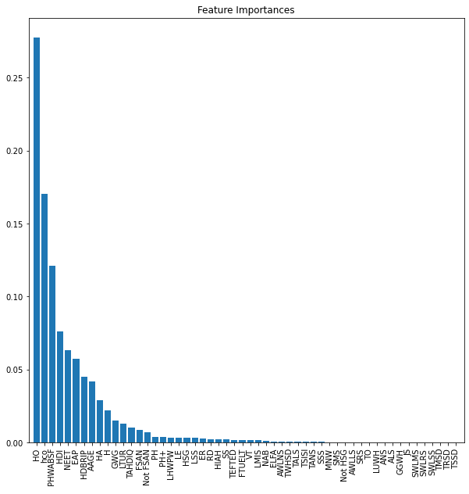
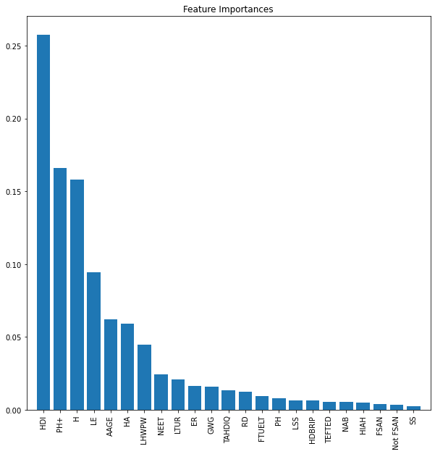
Models
United States
Global
Top 10 features:
HDI;PH+;H;LE;AAGE;HA;LHWPW;NEET;LTUR;ER.
Top 10 features:
HO;HCO;NEET;EAP;AAGE;HA;H;GWG;HDBRIP;PHWABSF.
Team#1 Ajay Kumar and Khawar Shehzad

Slide 10
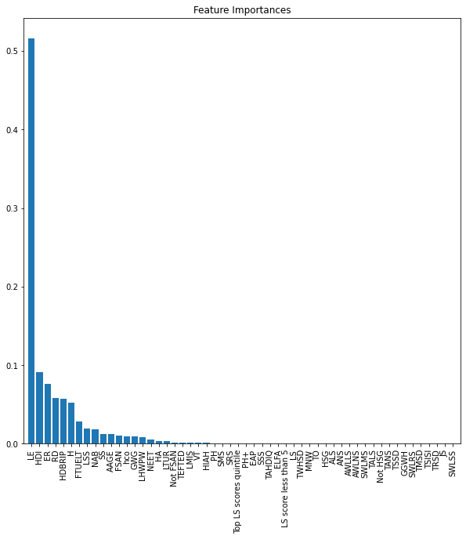
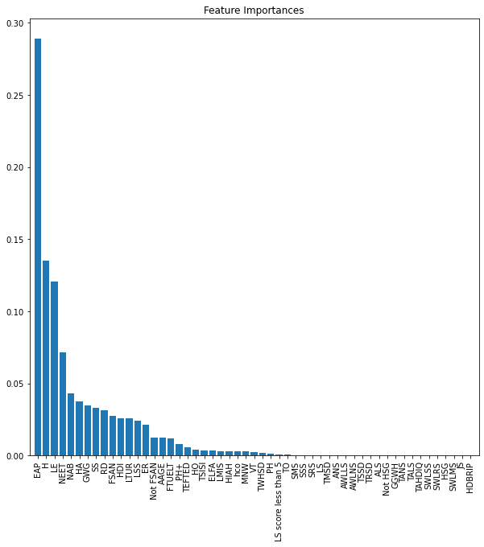
Models
Australia
Japan
Top 10 features:
LE;HDI;ER;RD;HDBRIP;H;FTUELT;LSS;NAB.
Top 10 features:
EAP;H;LE;NEET;NAB;HA;GWG;SS;RD;FSAN.
Team#1 Ajay Kumar and Khawar Shehzad

Slide 11
conclusion
COUNTRY | CORRELATION | COEFF_FEATURE
United States | AWLNS, HA, MNW, HDI, AAGE, TANS, TO, TANS,TO, HDI | HO, HCO, NEET, EAP, AAGE, HA, H, GWG, HDBRIP, PHWAB
Australia | ELFA, TWHSD, HIAH, MNW, LE, HDI, ER, AAGE | LE, HDI, ER, RD, HDBRIP, H, FTUELT, LSS, NAB
Japan | RD, H, FTUELT, NEET, GWG, VT, JS, MNW, TSISI | EAP, H, LE, NEET, NAB, HA, GWG, SS, RD, FSAN
Global | AWLNS, HA, MNW, AAGE, TANS, TO, TALS,TO, HDI | HDI, PH+, H, LE, AAGE, HA, LHWPW, NEET, LTUR, ER
In the conclusion table, we can conclude that combination of AWLNS: Adults with Low Numeracy Skills, HA: Housing Affordability, MNW: Median Net Wealth, HDI: Household Disposable Income, AAGE: Average Annual Gross Earnings, TANS: Top Adult Numeracy Scores, TO: Time Off, causes the increase in high suicide rates along years.
Japan has suicide rate due to, RD: Road Deaths, H: Homicides, FTUELT: Full-time Employees Earning Less Than Two-Thirds of Gross Median Earnings, NEET: Youth Not in Employment, Education, or Training, GWG: Gender Wage Gap, VT: Voter Turnout, JS: Job Strain, MNW: Median Net Wealth, TSISI: Time Spent in Social Interactions.
Team#1 Ajay Kumar and Khawar Shehzad

Slide 12
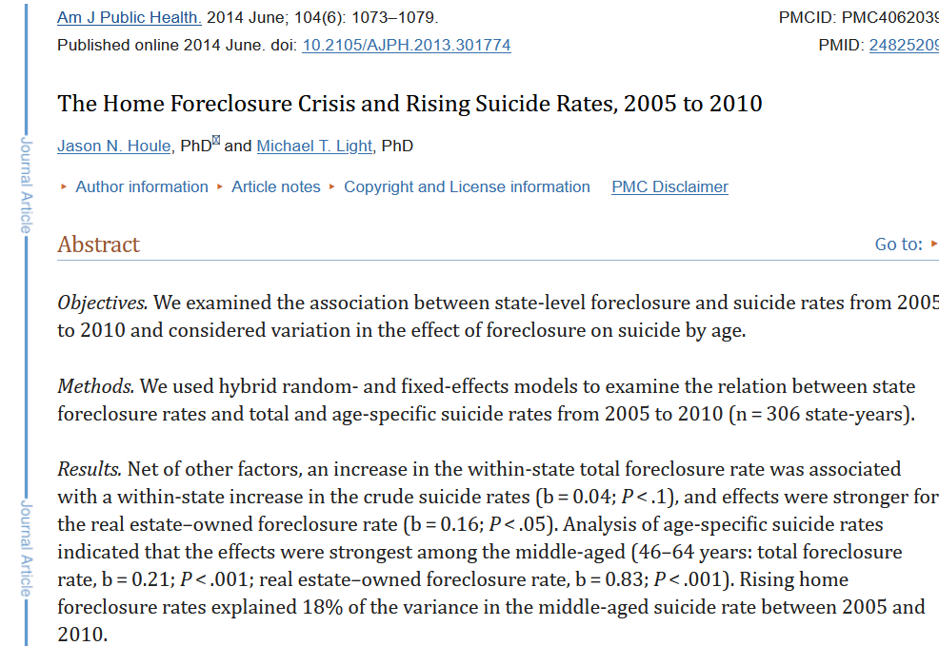
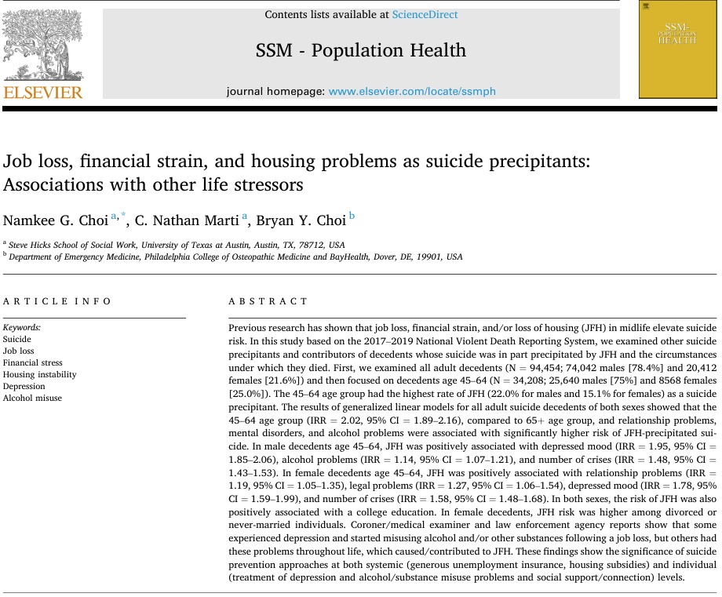
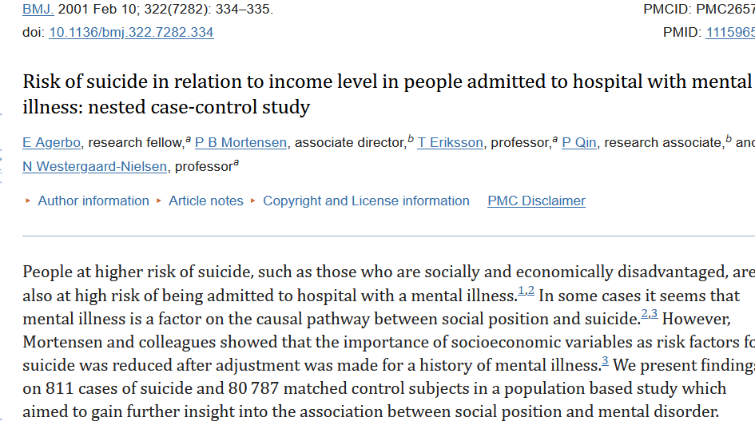
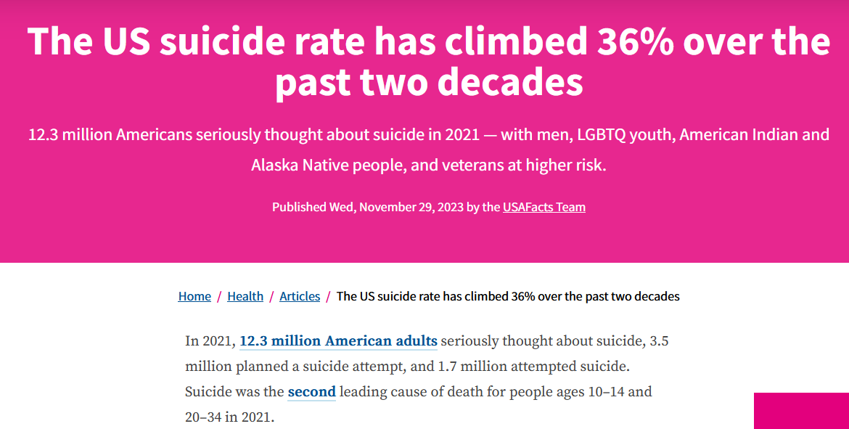
conclusion
Confirmation from articles,
Team#1 Ajay Kumar and Khawar Shehzad

Slide 13
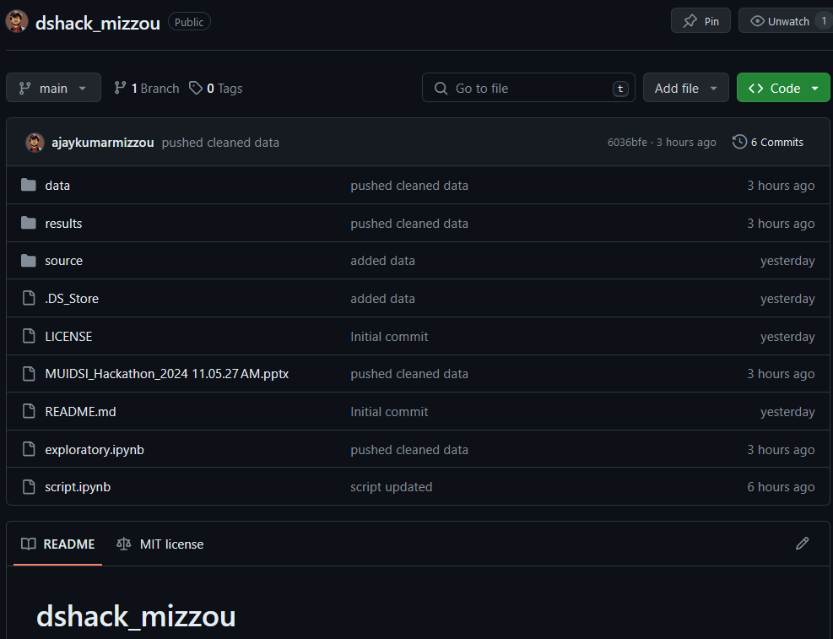
Code/data availability
Codes, processed-data category-wise divided ready for model training and testing, ML models' script and results are available at https://github.com/ajaykumarmizzou/dshack_mizzou.
Team#1 Ajay Kumar and Khawar Shehzad

Slide 14


Thank you very much.
Team#1 Ajay Kumar and Khawar Shehzad

